Slide 1
Resistance welding
  Fusion welding process.
  Gas welding and arc welding --------uses heat for melting and solidification of the joint only heat is used.
  Resistance welding -------- heat and pressure are used for welding.
  No filler material and no flux material.
  Heat source -------Resistance offered by work material to flow of current.
  Influencing parameters: Current; the pressure force and surface conditions.

Slide 2
Resistance welding ….
Principle:
  In resistance welding, a low voltage (approx.1 V) and very high current (15000 Amps) is passed through the joint for a very short time (approx. 0.25 sec.)
  The high current heats the joint (due to contact resistance at the joint) and melts it.
  The pressure on the joint is continuously maintained and the metal fuses together under pressure.

Slide 3
Resistance welding ….
The Heat generated in resistance welding is
  H = K.I²Rt where
  H= The total heat generated in the work piece, J
  I= Current in Amps
  t= time for which current is passing through the joint, in sec.
  R= Resistance of the joint, ohms
  K= a constant represents total heat loss from the joint.

Slide 4
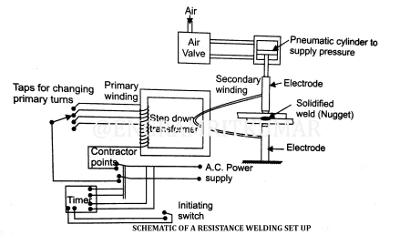
Resistance welding ….

Slide 5
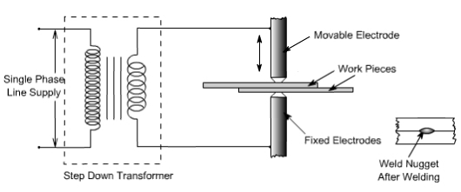
Resistance welding ….

Slide 6
Resistance welding ….
Low voltage, high current is supplied. AC with step down transformer is used.
Time should be precisely controlled.
The pressure (force) can be applied by mechanical, hydraulic or pneumatic means.
Heat balance:
For smaller thickness ------- smaller contact area
For larger thickness -----------larger contact area.
For different materials (different thermal conductivity).
The heat liberated in the lowest resistivity material is less i,e., use of electrode of large contact area near the metal which has higher electrical conductivity.

Slide 7
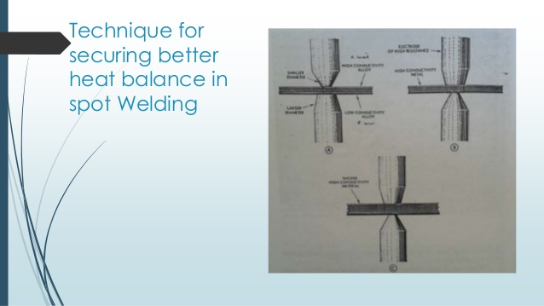
Resistance welding ….

Slide 8
Resistance welding ….
Electrodes for resistance welding
Functions of electrode
  To carry high current
  To transmit mechanical force
  To keep the plates in alignment during welding
Desired properties of electrodes
  Good electrical and thermal conductivity.
  Good mechanical strength.
Electrode Materials:
Copper - Cadmium (0.5 to 1.0%) ---for welding non ferrous metals
Copper - Chromium (0.5 to 0.8%) ---for mild steel and low alloy steel
Copper - Cobalt -Beryllium ----for stainless steel, tungsten and other alloy steels.

Slide 9
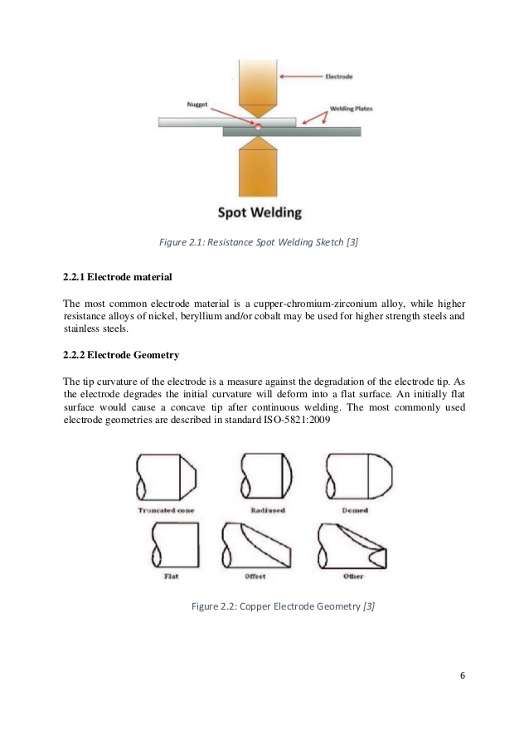
Resistance welding ….
Electrode tip shapes
Different shapes for different welding situations.
Pointed
Spherical
Dome
Flat
Eccentric
Other
Normally electrodes are air cooled water cooled.

Slide 10
Resistance welding ….
Advantages
  Easily Automated
  Suitable for mass production
  Dissimilar metals can be welded.
  Different thickness metals can be welded.
  Less distortion as heating is confined to less area.
Disadvantages.
  High cost. Economical only for mass production.
  Thicker materials difficult to weld.
  Large capacity machines required.
  Sophisticated controls.
Applications
  For thin sheets
  Automobile and aerospace industries
  For Carbon steel, stainless steel and nickel alloys.

Slide 11
Resistance welding ….
Types of Resistance welding processes
  Resistance Spot welding
  Resistance Seam welding
  Projection welding
  Upset welding
  Flash welding
  Percussion welding

Slide 12
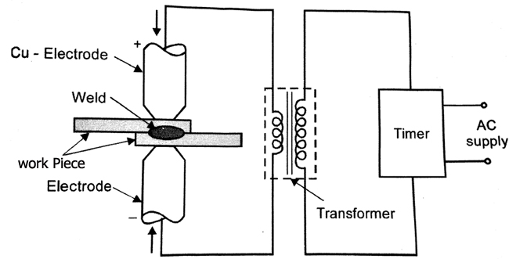
Resistance Spot Welding (RSW)
Principle:
Join sheet metal joints in lap joint, forming a small nugget at the interface.

Slide 13
Resistance Spot Welding (RSW) …..
Process:
  One electrode fixed and other movable to transmit force.
  Mechanical, hydraulic or pneumatic source is used for force transmission.
  A Low voltage & high current is passed for a short time.
  At interface heat is generated by the resistance offered to the current flow.
  After attaining the welding temperature, the pressure between electrodes squeezes the plates together to complete the weld.
  The current is switched off while pressure is still on, which enables the metal to regain strength by cooling.
  The depth of penetration approx. 0.3 to 0.8 t.

Slide 14
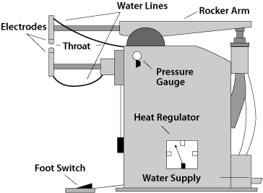
Resistance Spot Welding (RSW) …..
Equipment for Spot welding

Slide 15
Resistance Spot Welding (RSW) …..
Process : Sequence of events
  Squeeze Time -----Align and clamp the work piece.
  Weld Time -------- Current flow.
  Hold Time --------- Pressure is maintained without current.
  Off Time ----------Pressure is taken off. Plates will be moved for next spot.

Slide 16
Resistance Spot Welding (RSW) …..
Advantages
  All metals can be welded.
  No special care. Need only cleaning of weld surfaces.
  No filler metal and no edge preparation.
  High rate of production. (High speeds).
Disadvantages
  Only lap joints are possible.
  Not suitable for thicker metals (up to 6 mm max.)
  No leak proof.
  Indentation on sheets.
Applications
  For MS, SS, Al, Cu & Ni alloys.
  For dissimilar metals.
  Automobile bodies, refrigerator shelves, making boxes & containers.

Slide 17
Resistance Seam Welding (RSEW)
  Continuous spot welding process.
  Disc electrodes are used instead of cylindrical electrodes.
  Sheets are allowed to pass between two copper discs (Wheel-shaped) electrodes.
  Discs are rotated by an electric motor and the work is moved between them.
  The current is applied in a series of pulses at proper intervals.
  The timing is adjusted so that the pulses are either overlap with each other or does not overlap making intermittent nuggets.

Slide 18
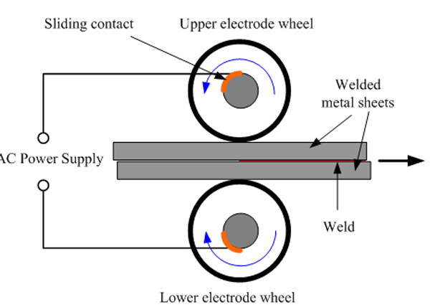
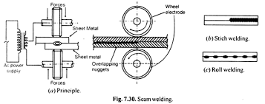
Resistance Seam Welding (RSEW) ….

Slide 19
Resistance Seam Welding (RSEW) ….
Advantages
  Leak proof joints.
  Independent control of weld time and speed of electrode wheels.
Disadvantages
  Only for thin metals (up to 5 mm)
  Higher currents and electrode pressure as compared to spot welding
  Indentations (electrode marks).
Applications
  For welding Ms, Al, Mg and Ni alloys.
  For making flanges for watertight tanks.
  For seam welding of pipes, fabrication of tanks etc.

Slide 20
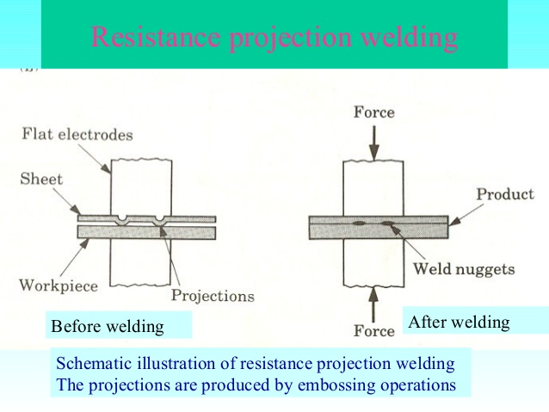
Resistance Projection Welding (RPW)
  In spot and seam welding, current concentration at the interface is achieved by shaping the electrodes and restricting the contact area, whereas, in projection welding the weld is located by projections raised on the surface of one of the sheets.
  When overlapped together, the two sheets touch only at the point of projections.
  When current is passed between the electrodes, the projections collapse under the electrode pressure and sheets are welded.
  Up to 6 projections are welded at the same time.

Slide 21
Resistance Projection Welding (RPW) ….

Slide 22
Resistance Projection Welding (RPW) ….
Advantages
  Longer electrode life (Due to large contact area).
  No electrode marks on work surface. No need of painting or polishing.
  Less chances of distortion around the weld area.
  Suitable for thick plates.
  Proper heat balance can be made by making projections in thicker sheets.
  Possible to weld more than one spot at a given time.

Slide 23
Resistance Projection Welding (RPW) ….
Disadvantages
  Prior operation of embossing (making projections) is required.
  Only suitable for strong metals (which can withstand electrode pressure on projections) i.e., copper, brass are not suitable as projections cannot withstand.
Applications
  Car bodies, office furniture, machine parts.
  For SS, G.I and CS

Slide 24
Upset welding
In this process, the two pieces to be joined are brought together to join with each other in butt joint.
These two pieces are held together tightly and current is applied.
The heat generated will bring the interfaces into plastic state, then the current is off and two parts are pressed together with upsetting force.
Upsetting removes the surface impurities and allows to form homogeneous joint.

Slide 25
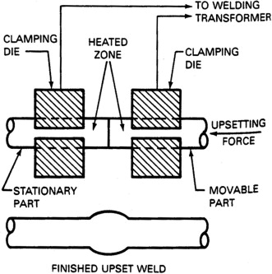
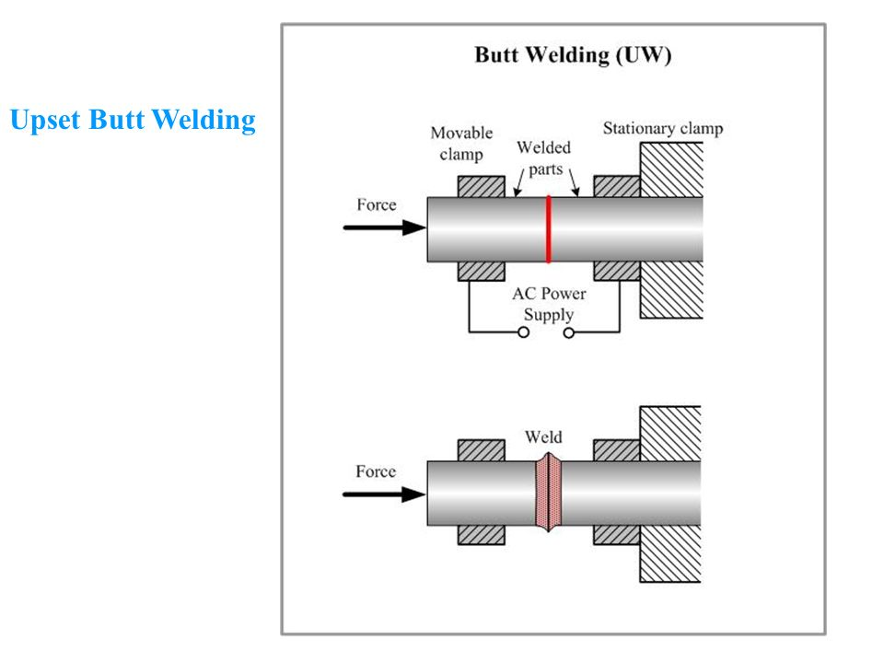
Upset welding ….

Slide 26
Upset welding …..
Advantages
  No melting of the metal. Hence no spatter.
Disadvantages
  Non uniform heat distribution.
  For smaller areas.
Applications
  For joining small ferrous and nonferrous strips
  The process is suitable for welding small wires, pipes, strips and copper tubes.

Slide 27
Flash welding
  Similar to upset welding except that the heat required for melting is obtained by means of arc rather than the simple resistance heating.
  Consists fixed and movable platen.
  The two plates are brought together and power supply is switched on.
  The two pieces are then separated to create the arc to melt the ends of the two pieces.
  Then, again the two pieces are brought together and the power is switched off. The two ends are fused together under force.
  Most of the metal melted will flash out through the joint and forms like a fin around the joint.

Slide 28
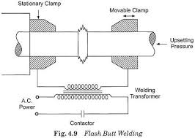
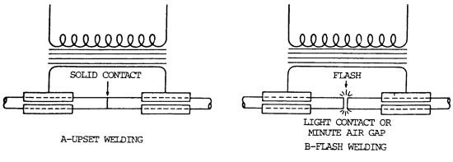
Flash welding ….

Slide 29
Flash welding ….
Advantages
  No edge preparation is required.
  Faster than other processes.
  Larger cross sectional area can be joined (2500 mm2).
Disadvantages
  Not suitable for CI, Pb, Zn alloys.
Applications
  For sheets, rods, wires and tubes.
  In automotive and aircraft products.

Slide 30
Percussion welding
  Similar to upset welding in which the welding is completed in a short time with a high intensity arc between two parts.
  Arc is struck between work surfaces and melt the joint.
  The molten surfaces are then squeezed by impacting of the work pieces forcing part of the liquid metal from the joint to go outside.
  Further movement of the movable part applies percussion force and makes it solidify under pressure.
  Used for small surface areas only (1 mm dia. wires), small rods, tubes etc.

Slide 31
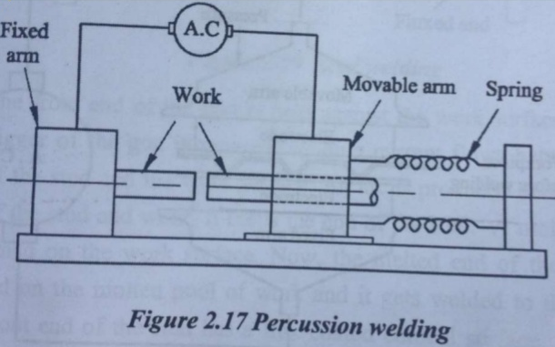
Percussion welding ….

Slide 32
THANK YOU

